Slide 1

TVSEP Data User Workshop
Internet use and non-farm employment
Presenter: MSc. Nguyet Tran
Institute for Environmental Economics and World Trade
Leibniz University Hannover

Slide 2
Overview
I. Introduction to the topic, data use, econometric models, results
II. Preparing data sets
III. Regression

Slide 3
I. Introduction
Promoting non-farm sectors is considered a key driver of ecomomic growth and poverty alleviation (UN, 2021)
Providing income, food security, reducing poverty and promoting welfare (Hoang et al., 2014, 2001; Do et al., 2022)
Challenges for rural developing countries
Rural members have access to low-paid and unstable non-farm activities (Brünjes & Diez, 2016)
Information asymmetries are prevalent in the labor markets in rural developing countries (Rajkhowa and Qaim, 2022)
Notes:
As internet access expands globally, it is transforming employment patterns by providing new opportunities in sectors like services, manufacturing, and entrepreneurship. This shift is particularly significant in rural and developing areas, where internet connectivity can serve as a bridge to better job opportunities, access to information, and skill development.

Slide 4
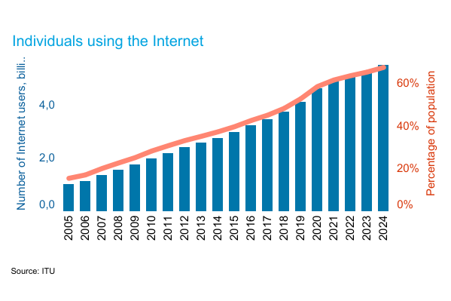





Introduction
One potential channel is to expand internet access and use
68 % (5.3 billion) people use internet globally (International Telecomunication Union, 2025)
Increasing chance suitable job/ higher paid activities
Reduce transaction cost/ Information cost
Increasing access to formal credit
Internet use
Raising individual productivity
Enhance human capital and social capital
Increasing the intention to start internet based-business
Sources: Self-formulation from Galperin&Viecens, 2017; Tan&Li, 2022

Slide 5
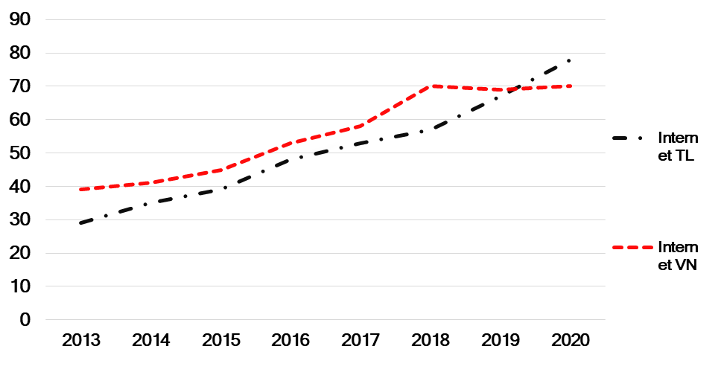
Why Thailand and Vietnam
Internet access and use increases rapidly (WB data, 2023)
Non-farm sectors are expanding (Amare et al., 2023)
Studies on the effects of internet use mainly focus on agriculture (Nguyen et al., 2021; Nguyen et al., 2023; Kaila & Tarp, 2019)
Fg.1 Shares internet users in Thailand and Vietnam
Source: World Bank Data, 2023
Notes:
Okay, Let‘s me talk about why Thailand and VN are interesting for this study.

Slide 6
Objectives
1. To investigate the effects of internet use on non-farm employment
2. To examine the heterogeneity in the impact of internet on different population groups
Notes:
Therefore, for the current study, we aim to attain 3 objectives. The first one is: to investigate the effect of using internet on non-farm employment in general. We also compare the difference off-farm wage employment and non-farm self-employment.
The second objective is to examine the unevent effect of using internet over different population groups.
And the third one is to investigate the effects of non-farm income on agricultural expenses

Slide 7
Data
Thailand
Vietnam
Thailand Vietnam Social Economic Panel (TVSEP) covers about 4400 households in 440 villages in Thailand and Vietnam
This study employs 2 waves of 2016 and 2017 with 6044 observations
Nakkhon phanom
Ubon Ratchathani
Ha Tinh
Buri Ram
Max
[0 to 100[
Hue
[100 to 200[
1
[200 to 300[
[300 to 400[
400+
400+
1+
400+
400+
< 1
Min
Dak Lak
[200 to 300[
400+
[300 to 400[
400+
400+
400+
400+
400+
1
400+
400+
Notes:
The datasets in this study were obtained from TVSEP long-term research project which is funed by German Research Foundation. The project examines social economics development and compares economic dynamics, poverty and vulnerability of the two country. The surveys were conducted in two countries and it coves 4400 households.
Until now, the survey has been conducted in nine waves.
This current study employs 2 waves of 2016 and 2017 with 6044 observations and the attrition rate os 5.17% per waves.

Slide 8
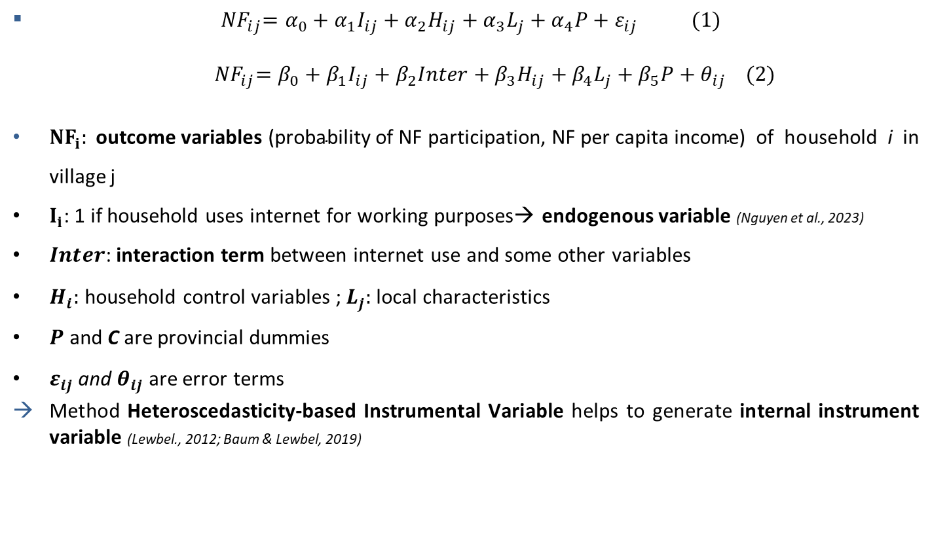
Emprirical Strategies

Slide 9

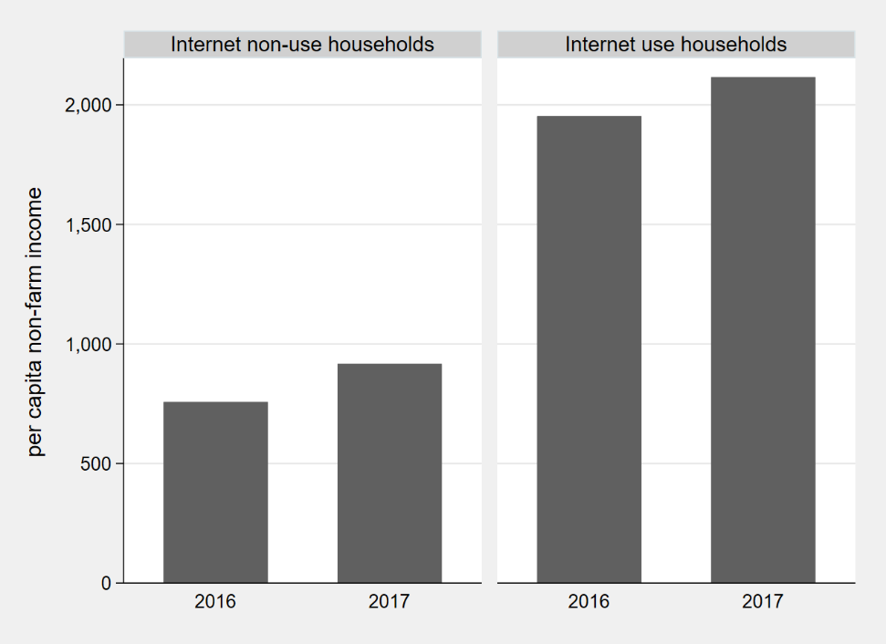
Data descriptives
Fg 2. Per capita non-farm income over years and internet use status
Source: own calculation based on TVSEP data

Slide 10
II. Preparing the data sets
Follow the dropbox link:
https://www.dropbox.com/scl/fo/dn6liq63c2p9ynuk3loyd/ANLUg8pdnUi3xvFn5mMcVqI?rlkey=m5nakgv7jihhx2ft1ldv5j14k&st=rk67i5pg&dl=0

Slide 11
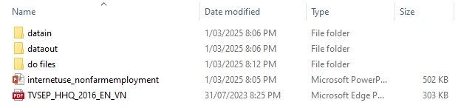
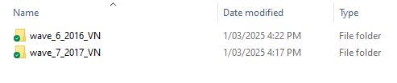
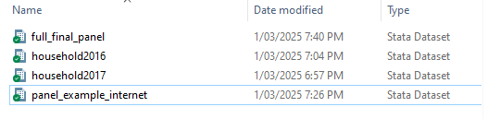
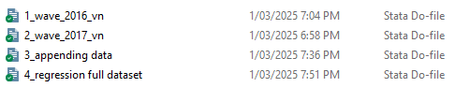
Instruction for files
Main Folders “internet&non-farm“
Folder of “datain“ contains original data (.dta)
Folder of “dataout“ contains all generated data files (.dta)
Folder of “do files“

Slide 12
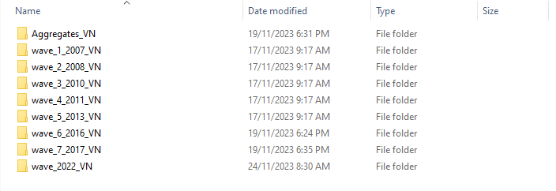
Data folders
Step 1: Determining data folders
These folders were sent when you apply for tvsep data on the homepage

Slide 13
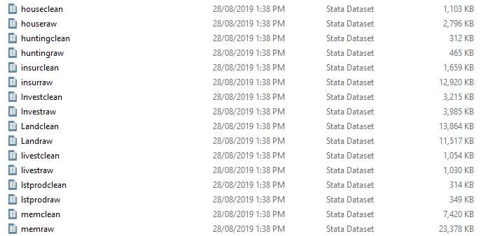
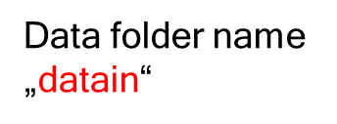
Extracting variables
Step 1.1. Locating dta file that contain our needed variables

Slide 14
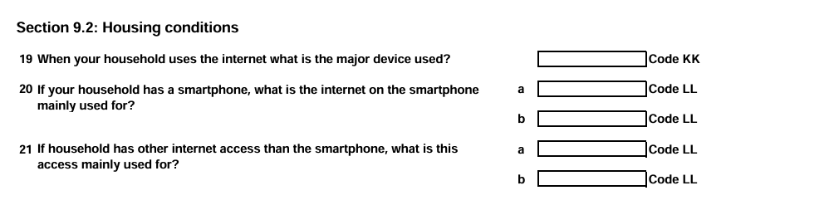
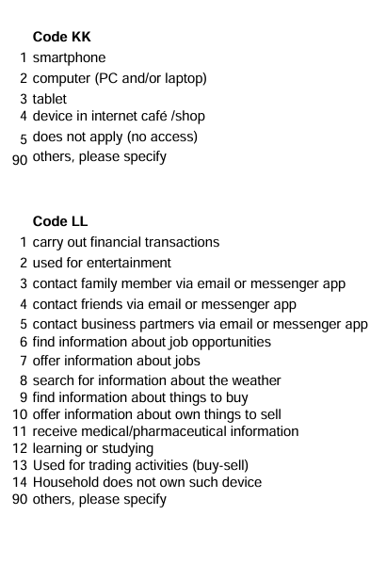
Extracting variables
Step 2. Coding variables
Using do files which are named as “1_wave_2016_vn“ and “2_wave_2017_vn“
The outcome data files will be saved in folder “dataout“

Slide 15
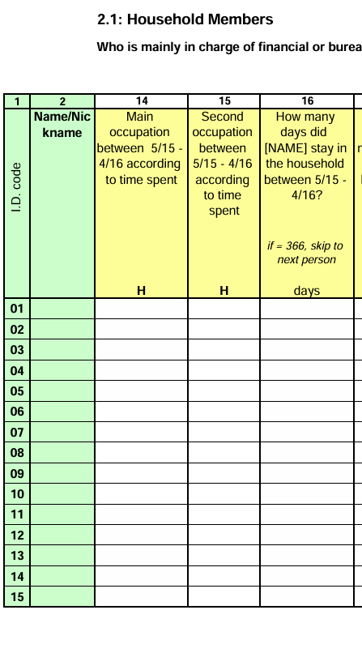
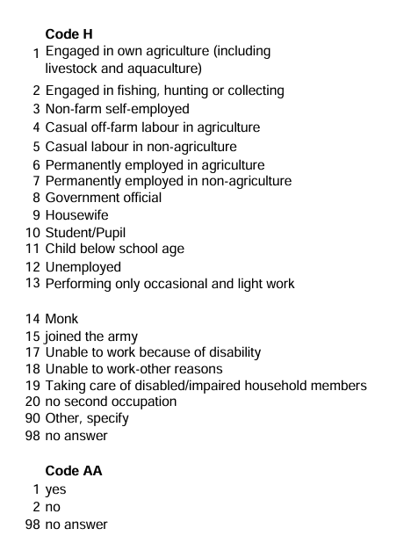
Looking at the questionnaire

Slide 16
Final data sets achievement
Step 2: Coding variables (cont)
By executing do files number 1 and 2, we obtain two datasets: “household2016.dta“, “household2017.dta“ with exactly the same generated variables in the folder “dataout “. Then we need to append datasets to achieve final panel.
Step 3: Appending datasets
After generating variable for each year, we will append the data to get the final data sets
→ Do file is named as “3_appending data“

Slide 17
III. Regression
Open the dataset „full_final_panel.dta“ in the folder “dataout “.
This dataset contains 6044 observations of households who use internet and engaging in non-farm employment of two year 2016 and 2017
Please execute the do file namely “4_regression full dataset“

Slide 18
Thank you for your attention!

Slide 19
References
Amare, M., Parvathi, P., & Nguyen, T. T. (2023). Micro insights on the pathways to agricultural transformation: Comparative evidence from Southeast Asia and Sub‐Saharan Africa. Canadian Journal of Agricultural Economics/Revue canadienne d'agroeconomie, 71(1), 69-87.
Do, M. H., Nguyen, T. T., Halkos, G., & Grote, U. (2022). Non-farm employment, natural resource extraction, and poverty: evidence from household data for rural Vietnam. Environment, Development and Sustainability, 1-38.
Galperin, H., & Fernanda Viecens, M. (2017). Connected for development? Theory and evidence about the impact of internet technologies on poverty alleviation. Development Policy Review, 35(3), 315-336.
International Telecommunication Union ( ITU ) World Telecommunication/ICT Indicators Database (accessed date 1st March 2025)
https://www.itu.int/en/ITU-D/Statistics/pages/stat/default.aspx
Hoang, T. X., Pham, C. S., & Ulubaşoğlu, M. A. (2014). Non-farm activity, household expenditure, and poverty reduction in rural Vietnam: 2002–2008. World Development, 64, 554-568. https://doi.org/10.1016/j.worlddev.2014.06.027
Lewbel, A. (2012). Using heteroscedasticity to identify and estimate mismeasured and endogenous regressor models. Journal of Business and Economic Statistics, 30(1), 67–80. https://doi.org/10.1080/07350015.2012.643126
Kaila, H., & Tarp, F. (2019). Can the Internet improve agricultural production? Evidence from Viet Nam. Agricultural Economics, 50(6), 675-691.
Nguyen, T. T., Nguyen, T. T., & Grote, U. (2023). Internet use and agricultural productivity in rural Vietnam. Review of Development Economics, 27(3), 1309-1326.

